Slide 1
Multimedia Technologies 20CST-334 Unit 2

Slide 2
Audio fundamental and representations
Digitization of Sound
Frequency & Bandwidth

Slide 3
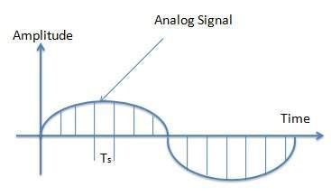
Digitization of Sound
A digital signal is superior to an analog signal because it is more robust to noise and can easily be recovered, corrected and amplified. For this reason, the tendency today is to change an analog signal to digital data.

Slide 4
Digitization of Sound
Pulse Code Modulation consists of three steps to digitize an analog signal:
Sampling
Quantization
Binary encoding
Before we sample, we have to filter the signal to limit the maximum frequency of the signal as it affects the sampling rate.
Filtering should ensure that we do not distort the signal, ie remove high frequency components that affect the signal shape.

Slide 5
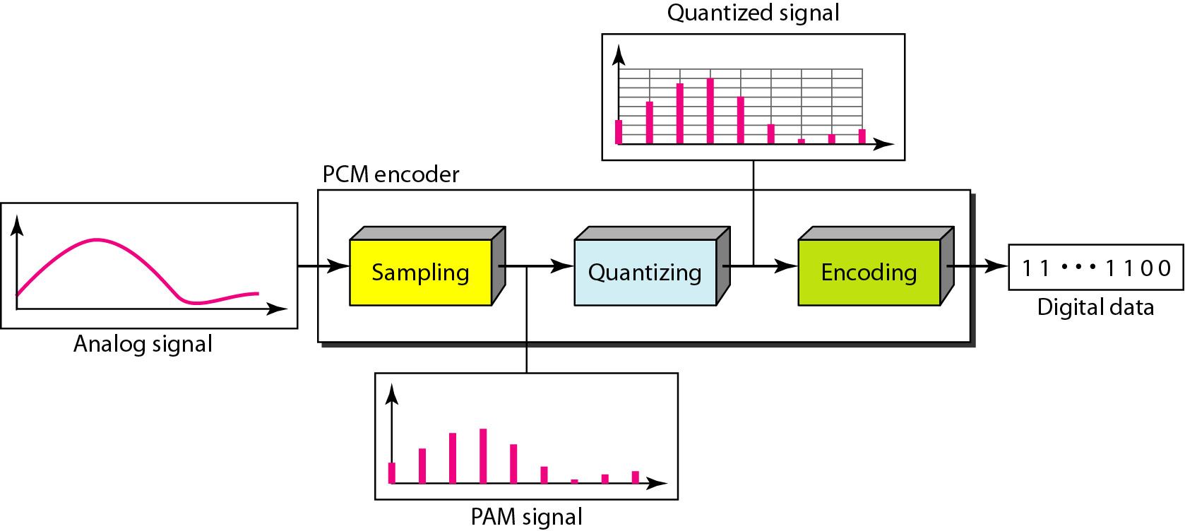
Digitization of Sound

Slide 6
Digitization of Sound
Sampling
Analog signal is sampled every T_{S} sec.
T_{s} is referred to as the sampling interval.
f_{s} = 1/T_{s} is called the sampling rate or sampling frequency.
There are 3 sampling methods:
Ideal - an impulse at each sampling instant
Natural - a pulse of short width with varying amplitude
Flattop - sample and hold, like natural but with single amplitude value

Slide 7
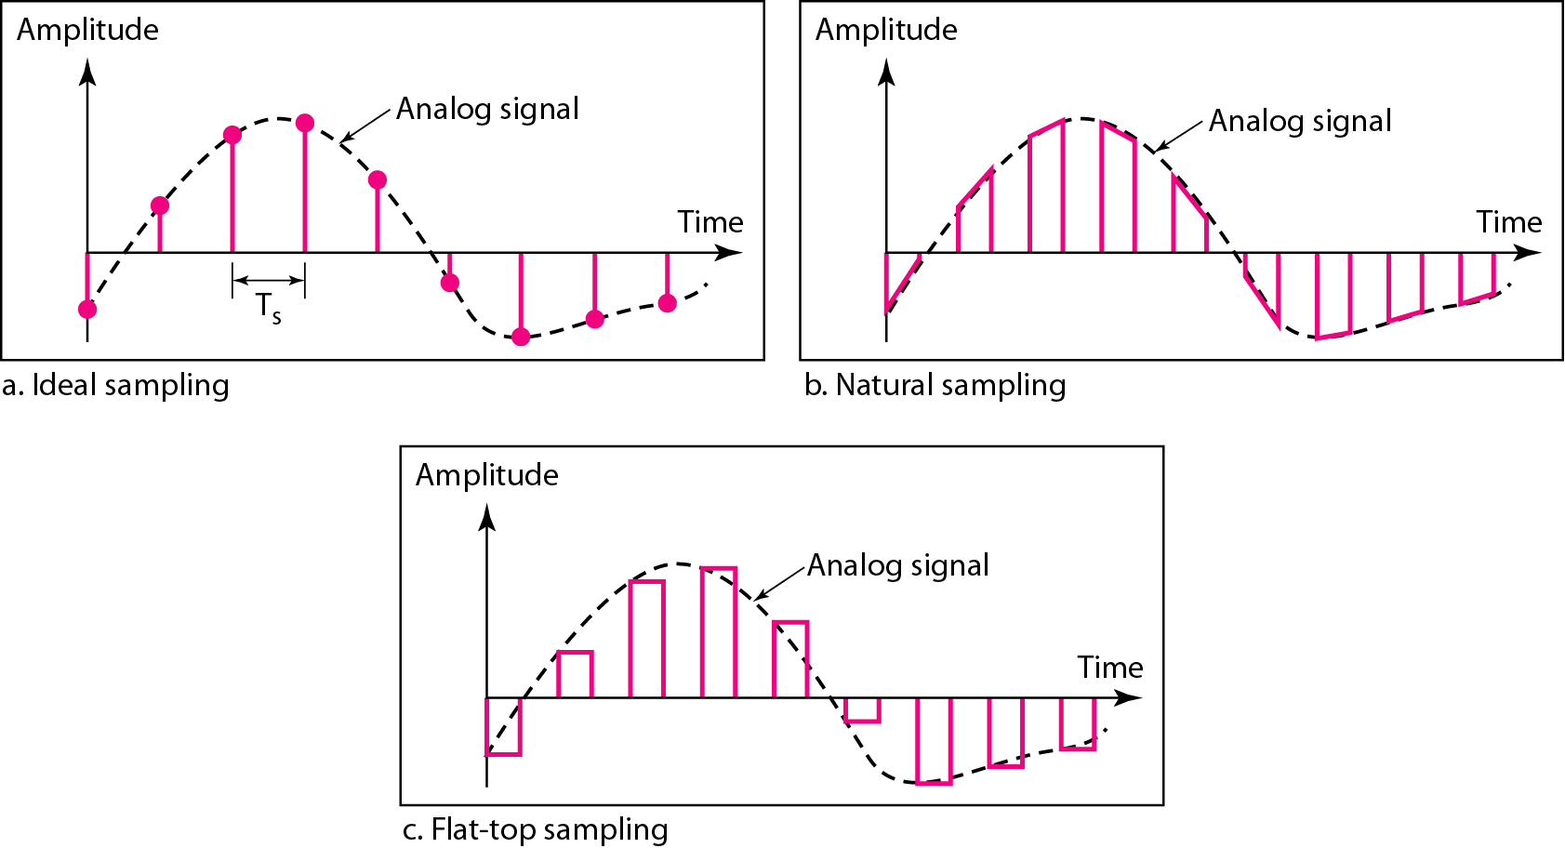
Digitization of Sound

Slide 8
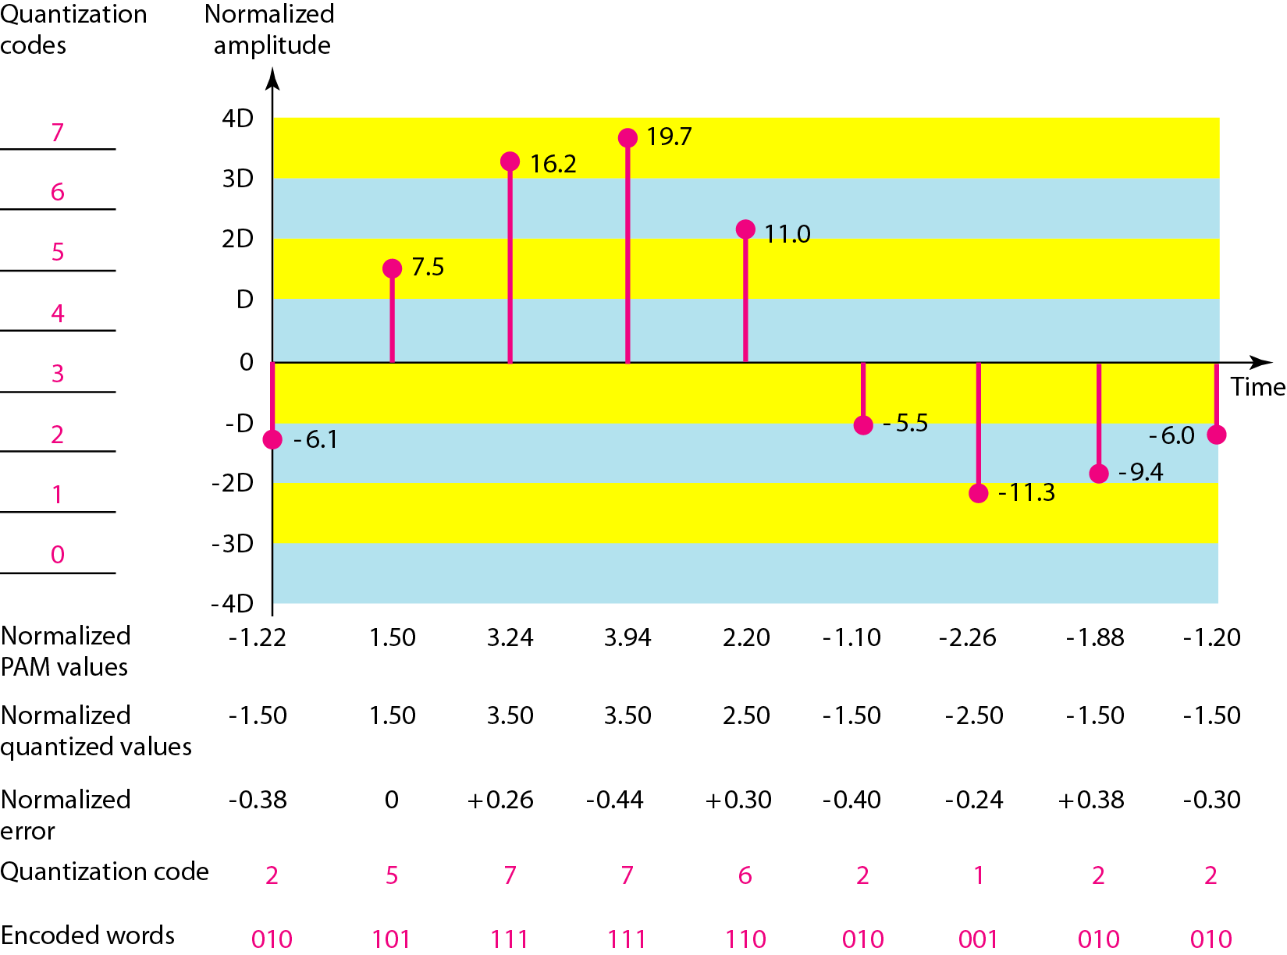
Quantization and Encoding of a sampled signal

Slide 9
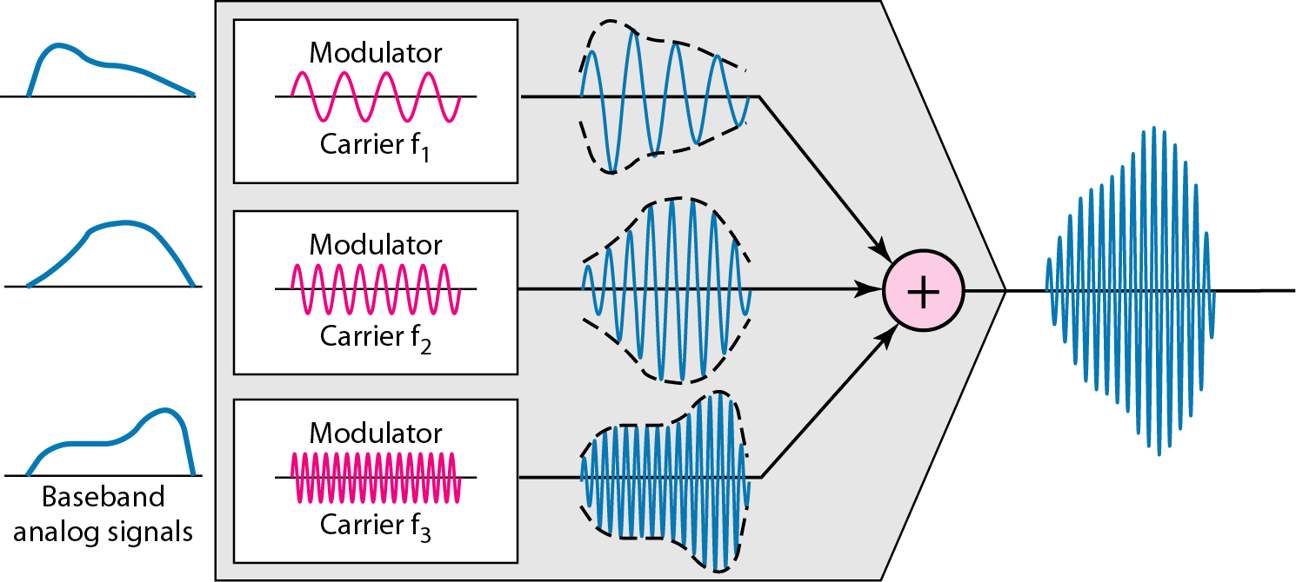
FDM process

Slide 10
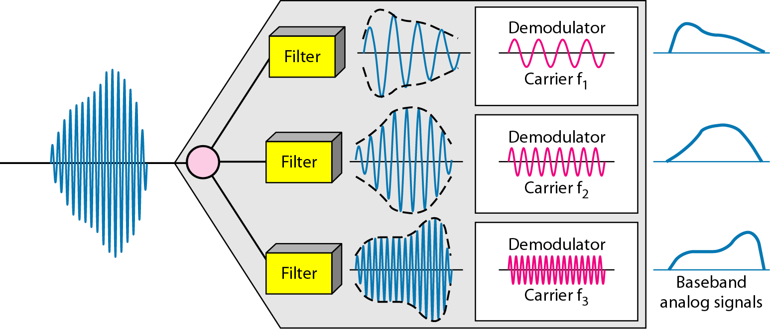
FDM demultiplexing example

Slide 11
Frequency, Bandwidth and Efficiency
Bandwidth and frequency both are the measuring terms of networking.
The basic difference between bandwidth and frequency is that bandwidth measures the amount of data transferred per second.
Frequency measure the number of oscillation of the data signal per second.
Efficiency can be achieved by multiplexing; i.e., sharing of the bandwidth between multiple users.

Slide 12
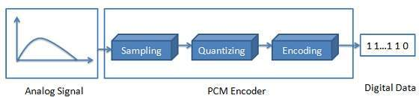
Digitization of sound
Encoding - Encoding converts the integer base-10 number to a base-2 that is a binary number. The output is a binary expression in which each bit is either a 1(pulse) or a 0(no pulse).

Slide 13
Frequency and Bandwidth
Bandwidth and frequency both are the measuring terms of networking. The basic difference between bandwidth and frequency is that bandwidth measures the amount of data transferred per second whereas the frequency measure the number of oscillation of the data signal per second. Let us study the comparison chart of the bandwidth and frequency.

Slide 14
Frequency and Bandwidth
Comparison Chart
BASIS FOR COMPARISON | BANDWIDTH | FREQUENCY
Basic | Bandwidth measures the amount of data that can be transmitted in per unit time. | Frequency measures the number of occurrences of a repeating event per unit time.
Unit | Bits/sec. | Hertz.

Slide 15
Frequency and Bandwidth
Bandwidth
Bandwidth is a term in networking used to measure the maximum amount of data that can be transmitted in per unit time. Bandwidth can be explained with the help of an example. Let us imagine that the bandwidth is a highway and number of vehicles on the highway is the amount of data being transmitted per unit time.
More the bandwidth, more the amount of data can be transmitted at per unit time. Bandwidth can also be explained as the range of signal between the higher (maximum) and lower(minimum) frequency that a signal can contain.

Slide 16
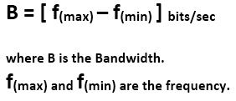
Frequency and Bandwidth
The formula to calculate the bandwidth is as follow

Slide 17
Frequency and Bandwidth
Frequency
Frequency” is the term to measure the number of oscillations that occur in a data signal in per second. In networking, the data is passed in the form of the signals which are made up of waves. The frequency of the signal is measured by the number of times the signal oscillates in per second.

Slide 18
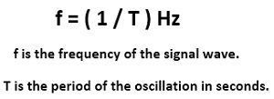
Frequency and Bandwidth:-
The formula to calculate the frequency is given by:

Slide 19
Frequency and Bandwidth
Key Differences Between Bandwidth and Frequency
Bandwidth measures the amount of data that a connection can transmit in a per unit time whereas, Frequency is a number of data packets arrived in per unit time.
Bandwidth is measured in bits/sec whereas, frequency is measured in hertz.

Slide 20
Multimedia Technologies
Decibel System
Data Rate
Audio file format

Slide 21
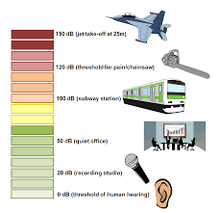
1. Decibel System
The decibel (dB) is a logarithmic unit used to measure sound level. It is also widely used in electronics, signals and communication. The dB is a logarithmic way of describing a ratio. The ratio may be power, sound pressure, voltage or intensity or several other things.
Decibels measure sound intensity (amplitude) Frequency, reported in Hertz (Hz), measures the number of sound vibrations in one second.
The definition of a decibel is a degree of loudness, or is a unit used to measure how powerful or loud a sound or signal. When you turn your iPod up as loud as it can possibly go, this is an example of when you listen to your music at the highest decibel.

Slide 22
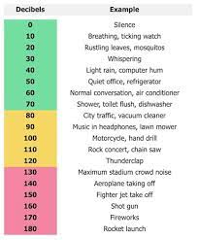
1. Decibel System
If you have to raise your voice to be heard by another person, you’re probably listening to more than 85 dB sounds.
A sound greater than 85 dB can result in hearing loss, the latter related to both the intensity of the sound and the period of exposure to it; eight hours of exposure to sounds measuring 90 dB can damage the human ear, and exposure to 140 dB can result in immediate damage and cause genuine pain as well.
Some common sounds and their intensity in decibels are as follows:
Near complete silence : 0 dB
Normal conversation : 60 dB
Whisper : 15 dB
Heavy city traffic : 85 dB
Baby crying : 110 dB
MP3 player at maximum volume : 105 dB
Toilet flushing : 75-85 dB
Noisy restaurant : 90 dB
Concerts : 120 dB
Jet engine : 120 dB

Slide 23
2. Data Rate
The speed at which data is transferred within the computer or between a peripheral device and the computer, measured in bytes per second.
Data rate example
It is generally measured in Mega bits per second(Mbps) or Mega bytes per second(MBps). For example, if bandwidth is 100 Mbps but data rate is 50 Mbps, it means maximum 100 Mb data can be transferred but channel is transmitting only 50 Mb data per second.
How do you calculate data rate?
Plug the amount of data (A) and transfer time (T) to solve for the rate, or speed (S), into the equation S = A ÷ T. For example, you might have transferred 25 MB in 2 minutes. First, convert 2 minutes to seconds by multiplying 2 by 60, which is 120. So, S = 25 MB ÷ 120 seconds.

Slide 24
2. Data Rate
Data rate vs Bandwidth
Bandwidth refers to the number of bits per second that a link can send or receive at one time, whereas data rate is the actual amount of data transferred.
Data rate vs Signal rate
Data rate – Number of data elements transmitted per second.
Signal rate – Number of signal elements transmitted per second.
Data rate vs Baud rate
Both Bit rate and Baud rate are generally used in data communication to measure the speed of data.
Bit rate is the transmission of a number of bits per second. On the other hand.
Baud rate is defined as the number of signal units per second.

Slide 25
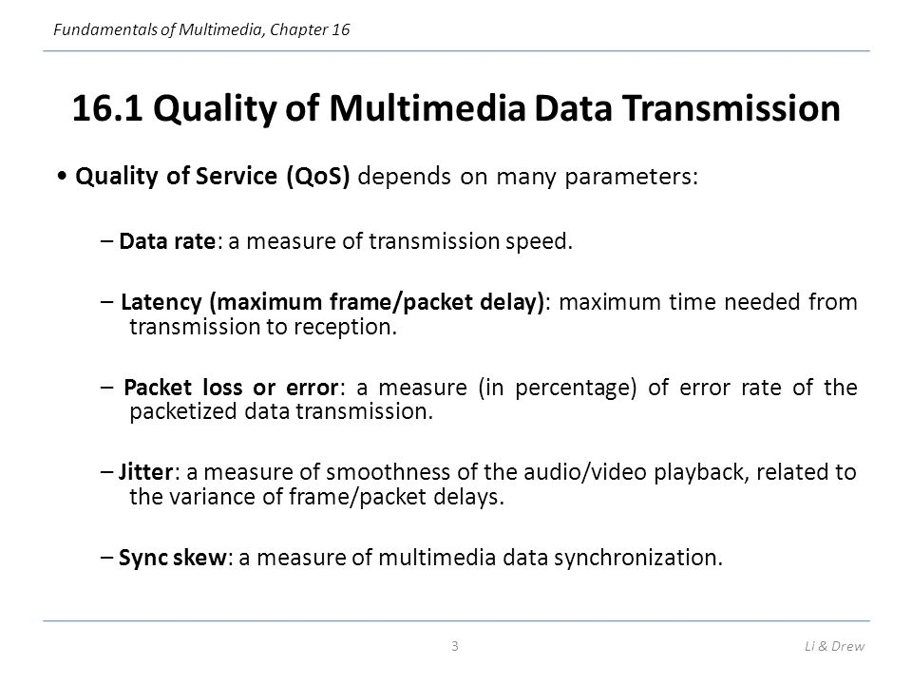
2. Data Rate

Slide 26
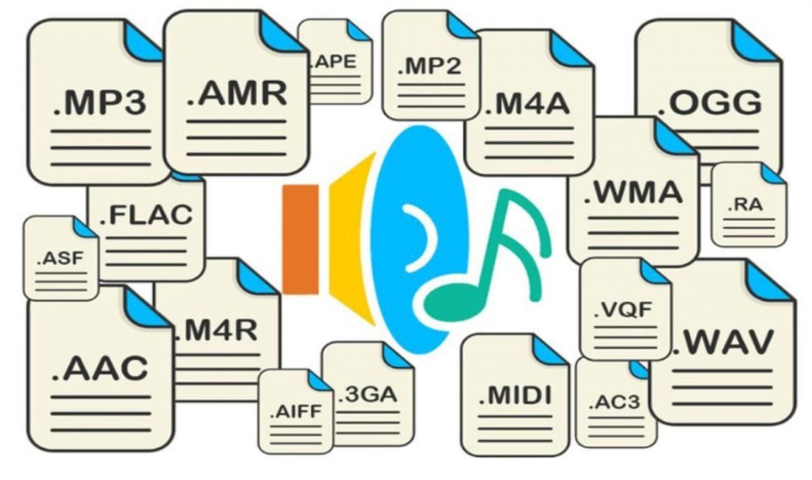
3. Audio file format
What is an Audio File Format?
Audio File Formats and Sound Quality

Slide 27
3. Audio file format
Audio Format Comparison
WAV (Waveform Audio) Files in this format are also referred to as wave files, their File extension is“.wav”. Developed by IBM and Microsoft, it was one of the first audio file types developed for the PC.
AIFF (Audio Interchange File Format) AIFF files have the File extension is “.aif” Around 1988, Apple developed this format, for Apple products.
ALAC (Apple Lossless Audio Codec) Unlike most of the other formats listed here, it’s file extension is not its name. ALAC files have the File extension is “.m4a” . As the name suggests it was developed by Apple.
FLAC (Free Lossless Audio Codec) File extension is “.flac”. FLAC is the format used by Amazon for their HD streaming service.
MP3 is an abbreviation of MPEG-1 (Moving Picture Experts Group - 1) Audio Layer 3, a data compression format for encoding digital audio, most commonly music. File extension is “.mp3” Introduced in 1993 it quickly became incredibly popular.
AAC stands for (Advanced Audio Coding). It first appeared in 1997, developed by Bell, Fraunhofer, Dolby, Sony, Nokia, LG Electronics, NEC, NTT Docomo, and Panasonic, to be the successor to MP3. File extension is “.aac”.
WMA (Windows Media Audio) It was Microsoft’s response to MP3. Like AAC, it attempted to, and succeeded in improving on MP3, sounding better at the same bitrate. File extension is “.wma”
OGG or OGG Vorbis, to give it its full title, is another format designed to improve on MP3. Its specification is in the public domain, so it is free for commercial or non-commercial use. File extension is “.ogg”

Slide 28
Sound Synthesis
Sound synthesis is the generation of sounds using algorithms, whether implemented in analogue or digital forms. It is an important application for cinema, multimedia, games and sound installations. It fits within the wider context of sound design, which is the discipline of acquiring, creating and manipulating sounds to achieve a desired effect or mood. Sound synthesis research within the Centre for Digital Music crosses several themes, including Audio Engineering and Augmented Instruments. We seek to uncover new synthesis techniques, as well as enhance existing approaches and adapt them to new applications. With a strong emphasis on performance, expression and evaluation, much of our research is focused on real world applications, empowering users and bringing sound synthesis to the forefront of sound design in the creative industries.

Slide 29
Sound Synthesis
There are multiple types of synthesis, among the basics and popular ones are :
Subtractive (Sylenth1, GMS, 3xOsc, Synth1)
FM (Sytrus, FM8, Operator, Dexed, DX7)
Additive (Harmor, Harmless, Loom)
*both Harmor and Harmless are actually additive synthesizers that functions like subtractive synthesizers
Wavetable (Serum, Massive)

Slide 30
Sound Synthesis
Subtractive synthesis functions by taking a basic waveform and running it through envelopes, filters, and effects.
FM synthesis functions by taking a waveform, and then modulating it with another waveform. You can also use a modulated waveform to modulate another waveform. It also runs through envelopes, filters, and effects.
Additive synthesis functions by adding on multiple sines to create a waveform. It too runs through envelopes, filters, and effects.
Wavetable synthesis is similar to subtractive synthesis, except that instead of having only basic waveforms, you get more waveforms in addition to them. And yeah, it too runs through envelopes, filters, and effects.

Slide 31
Musical Instrument Digitization Interface (MIDI)
Musical Instrument Digitization Interface (MIDI) provides a protocol or a set of rules, using which the musical note is directly recorded into the computer from musical instruments. A MIDI file is basically a list of commands to produce the sound. For example, pressing of a guitar key can be Unit 13: Multimedia Tools for WWW Lovely professional University 223 represented as a computer command. When the MIDI device processes this command, the result Notes will be the sound from the guitar. The protocol provides an effective means of conveying musical information as electronic data. Since MIDI files are small in size, these can be embedded while loading of Web pages and promptly played. Length of the MIDI files can be changed without degrading the quality of the signal. As the signals are stored as the notes played on the musical instrument, working on the MIDI files require knowledge of the music theory. The MIDI data stream is a unidirectional asynchronous bit stream at 31.25 Kbits/sec with 10 bits transmitted per byte (a start bit, 8 data bits, and one stop bit). The MIDI interface includes three different MIDI connectors, labeled as IN, OUT, and THRU. The MIDI data stream is usually originated by a MIDI controller, such as a musical instrument keyboard, or by a MIDI sequencer. A MIDI controller is a device which is played as an instrument, and it translates that into a MIDI data stream in real time. A MIDI sequencer is a device which allows MIDI data sequences to be captured, stored, edited, combined, and replayed. The MIDI data output from a MIDI controller or sequencer is transmitted via the devices’ MIDI OUT connector. The recipient of this MIDI data stream is commonly a MIDI sound generator or sound module, which will receive MIDI messages at its MIDI IN connector, and respond to these messages by playing sounds. Figure shows a simple MIDI system, consisting of a MIDI keyboard controller and a MIDI sound module

Slide 32
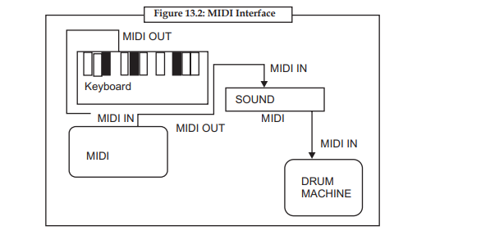
Musical Instrument Digitization Interface (MIDI)

Slide 33
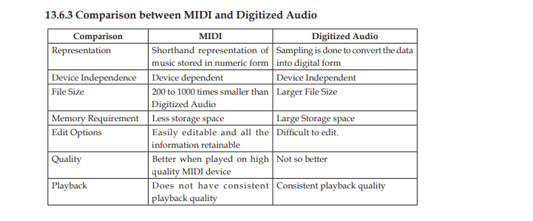
Musical Instrument Digitization Interface (MIDI)

Slide 34
Audio fundamental and representations
Compression and transmission of audio on Internet
Audio software and hardware

Slide 35
Compression and transmission of audio on Internet.
Audio data compression, not to be confused with dynamic range compression, has the potential to reduce the transmission bandwidth and storage requirements of audio data. Audio compression algorithms are implemented in software as audio codecs. In both lossy and lossless compression, information redundancy is reduced, using methods such as coding, quantization, discrete cosine transform and linear prediction to reduce the amount of information used to represent the uncompressed data.
Lossy audio compression algorithms provide higher compression and are used in numerous audio applications including Vorbis and MP3. These algorithms almost all rely on psychoacoustics to eliminate or reduce fidelity of less audible sounds, thereby reducing the space required to store or transmit them.

Slide 36
Compression and transmission of audio on Internet.
Audio compression the amount of data in a recorded waveform is reduced for transmission. This is used in CD and MP3 encoding, internet radio, and the like. Audio level compression is the dynamic range difference between loud and quiet of an audio waveform is reduced. This is used in guitar effects racks, recording studios, etc. Audio compression is a form of data compression designed to reduce the size of audio files. Audio compression algorithms are implemented in computer software as audio codecs. Generic data compression algorithms work with audio data but the compression ratios are low (around 50-60% of original size) and they do not work in real time and are therefore not practical. Specific audio "lossless" and "lossy" algorithms have been created. Lossy algorithms provide far greater compression ratios and are used in mainstream consumer audio devices.

Slide 37
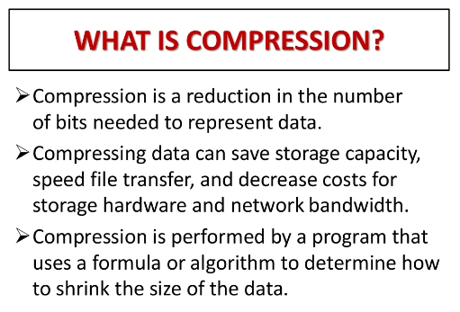
Compression and transmission of audio on Internet.

Slide 38
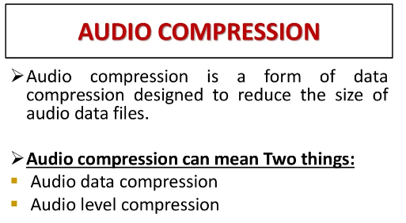
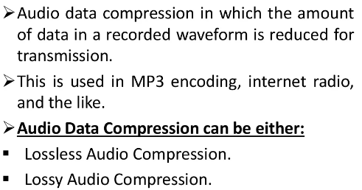

Slide 39
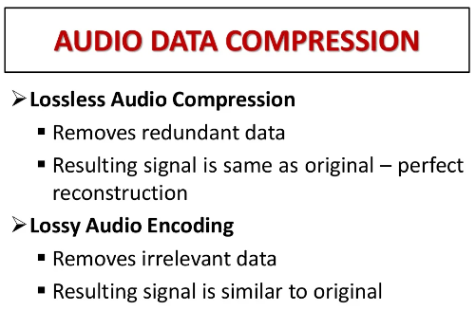
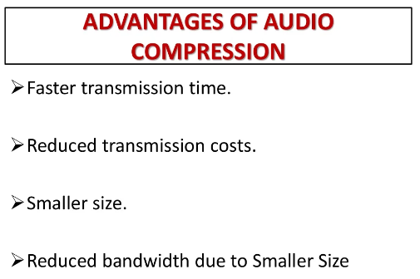
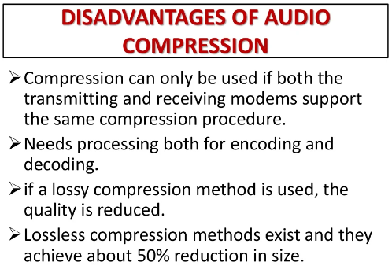
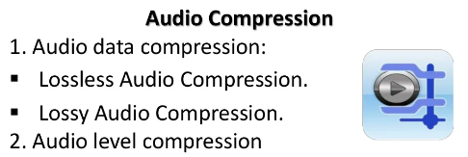

Slide 40
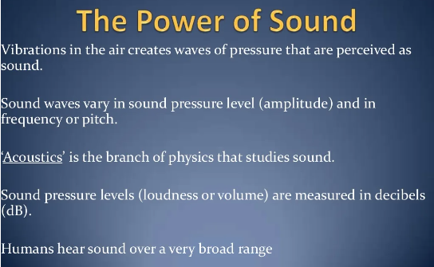
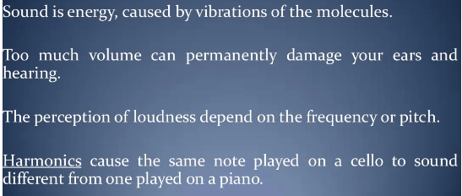

Slide 41


Slide 42
Chapter -4 Image fundamentals and representations

Slide 43
Adding sound to your multimedia project:-
1. Procedure for Windows Users
These instructions are tailored for one specific version of PowerPoint, but there’s not typically that much change between PowerPoint versions so you will still find them useful no matter what version you’re running.
How To Record Audio On PowerPoint
For this tutorial, we’ll assume you don’t have an external audio file to include in your presentation. At the same time, however, you badly want to embellish it and make it a unique, standalone piece.

Slide 44
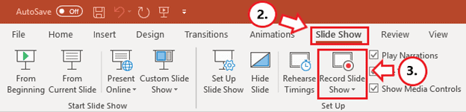
Adding sound to your multimedia project:-
First things first, ensure your microphone is enabled, and the speakers are working. If everything is set, here’s how to record your voice on PowerPoint:
1. For Starters, Design Your Presentation
Prepare your slides in the most creative and informative way you can. One trick is to limit the use of text, focusing on appropriate images to engage your audience better.
2. Select the “Slide Show” Tab
You have to be careful not to add your audio under the Insert option, as it only allows you to save your presentation as a video. The timings won’t be perfectly synchronized to move the slides automatically with the audio.

Slide 45
Adding sound to your multimedia project:-
3. Click On the “Record Slide Show” Option
Older versions of PowerPoint tend to start recording automatically. However, such versions still work, although they tend to have reduced functionality.
4. Select “Record from Beginning”
This isn’t cast in stone. You could still select Record from Current Slide as your needs dictate. It’s also worth noting that you can re-record any PowerPoint slide using either of these options.

Slide 46
Adding sound to your multimedia project:-
5. Click On the “Record” Icon
Naturally, this is the button with a red dot. For newer versions of PowerPoint, for example, the one in Office 2019, a dialog box will pop up, and all you need to do is click Start Recording.
Unless you’ve rehearsed and are a skilled speaker, you might be better off if you read carefully from a prepared script. In the checkboxes, PowerPoint will ask you to select what you want to record before your audio starts. Usually, these are:
Slide and animation timings
Narrations, ink, and laser pointer

Slide 47
Adding sound to your multimedia project:-
6. Record Your Narration
Here’s how to narrate a PowerPoint:
While you record, ensure you are relaxed and avoid reading too loudly or in a monotone. You need to read at a good volume and ideally, you want to sound natural (like you’re having a conversation). You can always click the Replay button if you would like to listen to your progress or confirm whether it was recorded in the first place.
For more recent versions of PowerPoint, there’s the Repeat icon. It’s a backward-pointing arrow very similar to the Undo button you see on your text editor. If you click this, everything starts all over again on the current slide.
7. Move to the Next Slide
Once you finish recording, simply click the STOP button. It’s the middle one with a square. If you’re recording for more than one slide, click the Advance button. It will tell you to advance to the following animation or slide.
For newer versions, simply select the Next button. It’s the short forward-pointing arrow just to the left of the Pause button. Be sure to stop speaking for a second or two to prevent the audio from cutting out in the next slide. You need to do this for all slides.

Slide 48
Adding sound to your multimedia project:-
8. Exit Recording
Press the Escape button (Esc) on your keyboard or simply click the X button on your screen when the recordings are complete. A speaker icon will appear on all slides that have audio.
9. Saving the Presentation
Click File and first save as a regular PowerPoint presentation with the .pptx extension.
10. Exporting the File
Select Export, then proceed to Create a Video. Although it’s optional, you should go for the Full HD (1080P). Next, choose Use Recorded Timings and Narrations and click on the icon labeled Create Video.
Follow the next pop-up window to save your video in your chosen location. You might want to monitor the progress indicator (PowerPoint won’t tell you the average time needed. You won’t receive any notification when it’s finished, either).

Slide 49
Adding sound to your multimedia project:-
Add External Audio
If you’re not up to the task of recording audio directly on PowerPoint, you only need to use a supported audio file type like MP3 or WAV. Here are the detailed steps on how to add audio to PowerPoint:
1. Select a Slide
Open PowerPoint and select a slide. Click Insert.
2. Select “Audio”
Just click on that speaker icon and from the tiny dropdown menu, select Audio on My PC

Slide 50
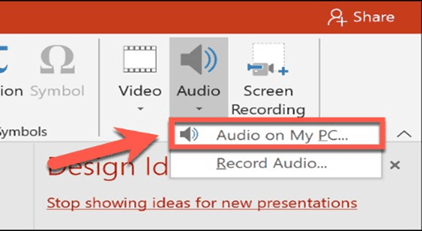
Adding sound to your multimedia project:-

Slide 51
Adding sound to your multimedia project:-
3. Locate the Audio File and Finish
Locate the audio file you want to insert from your PC and click the Insert button again.
The inserted audio appears as a speaker icon. When you select it, you will see playback options. During the presentation, simply hover over the icon to reveal playback options.

Slide 52
Color science
Color science encompasses many technologies, one of which is multimedia. Looking at the breadth of activities and industries that define color science can provide insight into current and future problems for multimedia imaging and their solutions.
There are several established color models used in computer graphics, but the two most common are the RGB model (Red-Green-Blue) for computer display and the CMYK model (Cyan-Magenta-Yellow-blacK) for printing.

Slide 53
Color science
Multimedia imaging requires the fundamental knowledge that constitutes such disciplines as mathematics, physics, chemistry, physiology, and psychology. We further require applied knowledge that constitutes disciplines including computer science, information processing, imaging science, and color science. This view of multimedia imaging places color science in a subordinate position. However, it can be worthwhile to exchange the positions. That is, multimedia imaging is but one of many technologies that exemplify color science. This approach has been described previously by the author regarding educational imperatives
(1) and as a pedantic vehicle for describing the relationships between user controls and resulting color for various color technologies
(2). This approach will be revisited within the context of multimedia imaging

Slide 54
Color science
Human Vision
The eye works like a camera, with the lens focusing an image onto the retina (upside - down and left - right reversed). The retina consists of an array of rods and three kinds of cones, so named because of their shape. The rods come into play when light levels are low and produce an image in shades of gray ("At night, all cats are gray!"). For higher light levels, the cones each produce a signal. Because of their differing pigments, the three kinds of cones are most sensitive to red (R), green (G), and blue {B) light.

Slide 55
Color science
Spectral Sensitivity of the Eye
The eye is most sensitive to light in the middle of the visible spectrum. Like the SPD profile of a light source for receptors we show the relative sensitivity as a function of wavelength. The blue receptor sensitivity is not shown to scale, because it is much smaller than the curves for red or green. Blue is a late addition in evolution (and, statistically, is the favorite color of humans, regardless of nationality — perhaps for this reason: blue is a bit surprising!). The following figure shows the overall sensitivity as a dashed line, called the luminous - efficiency function. It is usually denoted V(X) and is the sum of the response curves to red, green, and blue.

Slide 56
Color Palettes:-
Palettes or color look up tables (CLUT) are mathematical tables that
Define the color of a pixel displayed on the screen Paint programs provide a palette tools for displaying available colors – not uniform across programs or platforms Color graphics adaptors work with 256 shades of each color producing over 16 million colors (256 x 256x 256).

Slide 57
Color Palettes:-
Palette Flashing Problem
• Palette Flashing occurs when you use a series of images each with its own color palette. When the new image replaces the older one a flash occurs on the screen - a serious problem in multimedia
• Solution – use a single palette for all project images or– fade each image to white or black before showing the next image since white and black are present in most palettes

Slide 58
Color Palettes:-
Dithering
• Dithering is a process where the color value of each pixel is changes to the closest matching color value in the target palette, using a mathematical algorithm.
• It “averages” the color over an area and is usually close to the original color.
• Dithering software is usually built into image editing and multimedia program

Slide 59
Color Palettes:-
Image File Formats
• MAC has a single standard format PICT
• Windows uses device independent bitmaps DIBs written as .bmp files, which is a windows bitmap file
• TIFF ( tagged interchange file formats) are universal bitmap files – used in desktop publishing

Slide 60
Color Palettes:-
Adaptive Palette
Instead of specifying a Standard Palette that includes entries for any image, you can instead specify a palette that is restricted only to colors that are most appropriate for the image that you want to palettize. Such palettes are called Adaptive Palettes. Most modern graphics software can create an Adaptive Palette for any image automatically, so this is no longer a difficult proposition.

Slide 61
Color Palettes:-
Hardware Palette
In the early days of computer graphics, memory was expensive and capacities were small. It made economic sense to maximize the use of digital color palettes where possible, to minimize the amount and size of memory required. This was particularly important in the design of graphics display cards, which required sufficient memory to store at least one full frame of the display. By adding a small special area of memory on the card for use as a palette, it was possible to reduce the size of the main frame memory substantially. This was achieved at the expense of complexity, because now every image that was displayed had to have a palette.

Slide 62
Color science
Color science encompasses many technologies, one of which is multimedia. Looking at the breadth of activities and industries that define color science can provide insight into current and future problems for multimedia imaging and their solutions.

Slide 63
Color science
Multimedia imaging requires the fundamental knowledge that constitutes such disciplines as mathematics, physics, chemistry, physiology, and psychology. We further require applied knowledge that constitutes disciplines including computer science, information processing, imaging science, and color science. This view of multimedia imaging places color science in a subordinate position. However, it can be worthwhile to exchange the positions. That is, multimedia imaging is but one of many technologies that exemplify color science. This approach has been described previously by the author regarding educational imperatives
(1) and as a pedantic vehicle for describing the relationships between user controls and resulting color for various color technologies
(2). This approach will be revisited within the context of multimedia imaging

Slide 64
Color science
Human Vision
The eye works like a camera, with the lens focusing an image onto the retina (upside - down and left - right reversed). The retina consists of an array of rods and three kinds of cones, so named because of their shape. The rods come into play when light levels are low and produce an image in shades of gray ("At night, all cats are gray!"). For higher light levels, the cones each produce a signal. Because of their differing pigments, the three kinds of cones are most sensitive to red (R), green (G), and blue {B) light.

Slide 65
Color science
Spectral Sensitivity of the Eye
The eye is most sensitive to light in the middle of the visible spectrum. Like the SPD profile of a light source for receptors we show the relative sensitivity as a function of wavelength. The blue receptor sensitivity is not shown to scale, because it is much smaller than the curves for red or green. Blue is a late addition in evolution (and, statistically, is the favorite color of humans, regardless of nationality — perhaps for this reason: blue is a bit surprising!). The following figure shows the overall sensitivity as a dashed line, called the luminous - efficiency function. It is usually denoted V(X) and is the sum of the response curves to red, green, and blue.

Slide 66
Color science
Light and Spectra
Recall from high school that light is an electromagnetic wave and that its color is characterized by the wavelength of the wave. Laser light consists of a single wavelength — for example, a ruby laser produces a bright, scarlet beam. So if we were to plot the light intensity versus wavelength, we would see a spike at the appropriate red wavelength and no other contribution to the light.

Slide 67
COLOR MODELS IN IMAGES - MULTIMEDIA
We now have had an introduction to color science and some of the problems that crop up with respect to color for image displays. But how are color models and coordinates systems really used for stored, displayed, and printed images?
RGB Color Model for CRT Displays
We usually store color information directly in RGB form. However, we note from the previous section that such a coordinate system is in fact device - dependent.
We expect to be able to use 8 bits per color channel for color that is accurate enough. In fact, we have to use about 12 bits per channel to avoid an aliasing effect in dark image areas — contour bands that result from gamma correction, since gamma correction results in many fewer available integer levels.
For images produced from computer graphics, we store integers proportional to intensity in the frame buffer. Then we should have a gamma correction LUT between the frame buffer and the CRT. If gamma correction is applied to floats before quantizing to integers, before storage in the frame buffer, then we can use only 8 bits per channel and still avoid contouring artifacts.

Slide 68
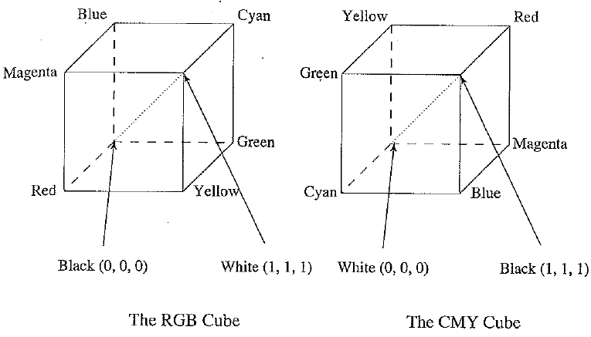
RGB and CMY color cubes. (This figure also appears in the color insert section.)

Slide 69
COLOR MODELS IN IMAGES - MULTIMEDIA
Subtractive Color: CMY Color Model
So far, we have effectively been dealing only with additive color. Namely, when two light beams impinge on a target, their colors add; when two phosphors on a CRT screen are turned on, their colors add. So, for example, red phosphor + green phosphor makes yellow light.
But for ink deposited on paper, in essence the opposite situation holds: yellow ink subtracts blue from white illumination but reflects red and green; which is why it appears yellow!
So, instead of red, green, and blue primaries, we need primaries that amount to — red, — green, and — blue; we need to subtract R, G, or B. These subtractive color primaries are cyan (C), magenta (M), and yellow (Y) inks. The above figure shows how the two systems, RGB and CMY, are connected. In the additive (RGB) system, black is "no light", RGB — (0, 0, 0). In the subtractive CMY system, black arises from ^subtracting all the light by laying down inks with C = M = Y = 1.

Slide 70

COLOR MODELS IN IMAGES - MULTIMEDIA
Transformation from RGB to CMY
Given our identification of the role of inks in subtractive systems, the simplest model we can invent to specify what ink density to lay down on paper, to make a certain desired RGB color, is as follows:
Additive and subtractive color: (a) RGB is used to specify additive color; (b) CMY is ased to specify subtractive color. (This figure also appears in the color insert section.)

Slide 71
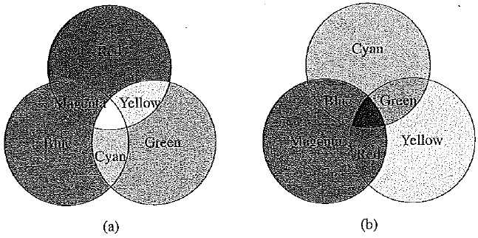
COLOR MODELS IN IMAGES - MULTIMEDIA

Slide 72
Color palettes

Slide 73
Color palettes
A color palette, in the digital world, refers to the full range of colors that can be displayed on a device screen or other interface, or in some cases, a collection of colors and tools for use in paint and illustration programs.
A color palette is a combination of colors used by designers when designing an interface. When used correctly, color palettes form the visual foundation of your brand, help to maintain consistency, and make your user interface aesthetically pleasing and enjoyable to use.

Slide 74
Color palettes
7 different kinds of color schemes?
The seven major color schemes are monochromatic, analogous, complementary, split complementary, triadic, square, and rectange (or tetradic). ... Let's examine each in more detail.
Monochromatic. ...
Analogous. ...
Complementary. ...
Split Complementary. ...
Triadic. ...
Square. ...
Rectangle.
Colours are there in color palette?
Dichrome palettes Each permuted pair of red, green, and blue (16-bit color palette, with 65,536 colors)

Slide 75
Color palettes
Color palette in computer?
In computer graphics, a palette is the set of available colors from which an image can be made.

Slide 76
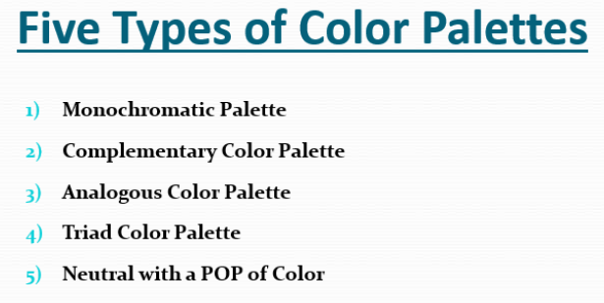
Color Palettes

Slide 77
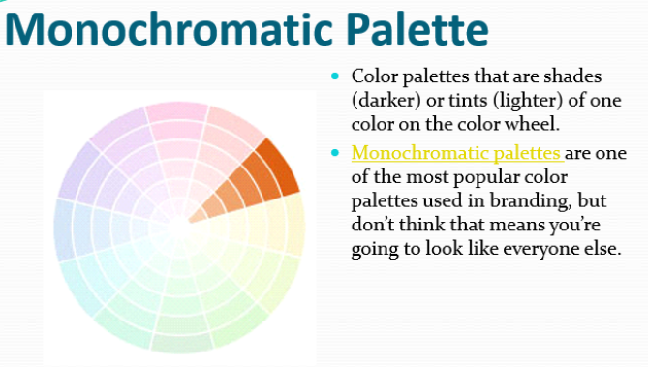
Color Palettes

Slide 78
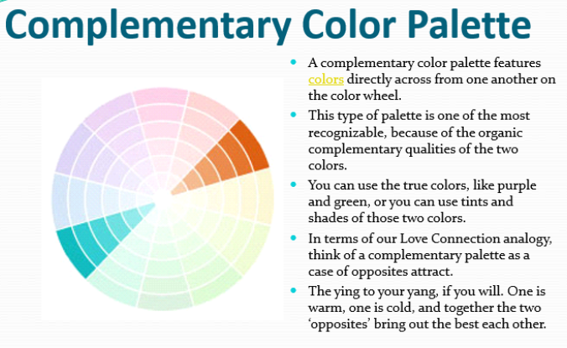
Color Palettes

Slide 79
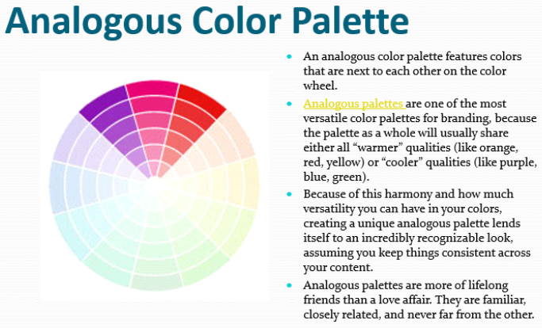
Color Palettes

Slide 80
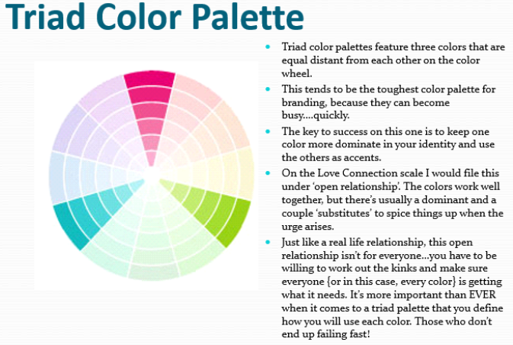
Color Palettes

Slide 81
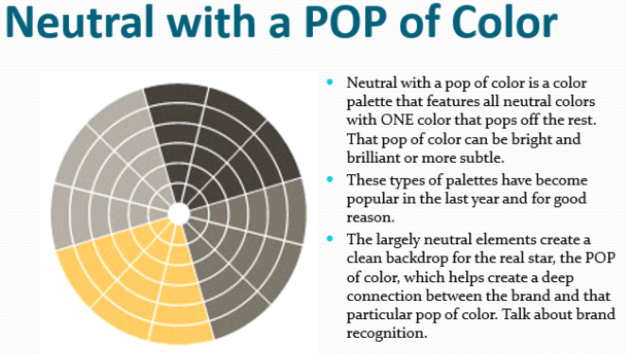
Color Palettes

Slide 82
Color Palettes
Adaptive Palette
Instead of specifying a Standard Palette that includes entries for any image, you can instead specify a palette that is restricted only to colors that are most appropriate for the image that you want to palettize. Such palettes are called Adaptive Palettes. Most modern graphics software can create an Adaptive Palette for any image automatically, so this is no longer a difficult proposition.

Slide 83
Color Palettes:-
Hardware Palette
In the early days of computer graphics, memory was expensive and capacities were small. It made economic sense to maximize the use of digital color palettes where possible, to minimize the amount and size of memory required. This was particularly important in the design of graphics display cards, which required sufficient memory to store at least one full frame of the display. By adding a small special area of memory on the card for use as a palette, it was possible to reduce the size of the main frame memory substantially. This was achieved at the expense of complexity, because now every image that was displayed had to have a palette.

Slide 84
Basic Image Processing
Before we jump into image processing, we need to first understand what exactly constitutes an image. An image is represented by its dimensions (height and width) based on the number of pixels. For example, if the dimensions of an image are 500 x 400 (width x height), the total number of pixels in the image is 200000.

Slide 85
Basic Image Processing
This pixel is a point on the image that takes on a specific shade, opacity or color. It is usually represented in one of the following:
Grayscale - A pixel is an integer with a value between 0 to 255 (0 is completely black and 255 is completely white).
RGB - A pixel is made up of 3 integers between 0 to 255 (the integers represent the intensity of red, green, and blue).
RGBA - It is an extension of RGB with an added alpha field, which represents the opacity of the image.

Slide 86
Basic Image Processing
Image processing is the process of transforming an image into a digital form and performing certain operations to get some useful information from it. The image processing system usually treats all images as 2D signals when applying certain predetermined signal processing methods.
There are five main types of image processing:
Visualization - Find objects that are not visible in the image
Recognition - Distinguish or detect objects in the image
Sharpening and restoration - Create an enhanced image from the original image

Slide 87
Basic Image Processing
Pattern recognition - Measure the various patterns around the objects in the image
Retrieval - Browse and search images from a large database of digital images that are similar to the original image

Slide 88
Use of image editing software
Why Do We Use Image Editing Softwares?
You can take pictures using a good digital point and shoot or SLR camera and get good quality photos, but if you want to turn the image into an art form or tweak it enough to make it a completely new image, using an image editing software is a must.
Image editing softwares are an important part of every graphic designer and photographer’s life. In this era of social networking and online marketing, businesses worldwide are trying hard to leverage online media to build and reinforce brands that assist in generating new avenues for lead generation and revenue. With the prices of digital cameras nose-diving and camera features getting richer by the year, the use of images, especially in the online world, has witnessed a steady increase over the years. It is not hard to guess why pictures have become an integral part of social media and business.

Slide 89
Use of image editing software
Pictures derived from a camera may end up having extra light, shades of darkness or distortions, such as graining, blurring, or unnecessary detailing that could take the shine off your photo. Photo editing softwares provide the opportunity to rectify these errors and leave you with high-quality photographs. They can help you get rid of unsightly red eyes, too much brightness or contrast, stains, or an unnecessary background. Features, such as cropping, rotation, resizing and adjustments in brightness and contrast are part and parcel of any image editing software.
The reasons why you may want to edit a picture using a photo editing software are:

Slide 90
Use of image editing software
Image Enhancement
If you want your images to have details that pop out and seek attention, you could very well put them through an image enhancement process. You will be able to transform a dull and lifeless camera image into an eye-catching exhibit. However, what you can achieve with image enhancement technique is not restricted to:
Increasing and decreasing contrast
Making an image lighter or darker
Cropping images to professional standards
Removing reflections in a mirror or glass pane
Resizing images to a specific size

Slide 91
Use of image editing software
Photo Restoration
If you have not preserved your old photos, there will be significant wear and tear that can make the photo unsuitable for use or belittle you when sharing. If you have old, worn-out photos of your old folks lying in an old trunk somewhere in your backyard or attic, you can fetch them and share them with your friends sans the embarrassment, after they are restored to its original quality. Photo Restoration techniques help you bring back the luster to your old photos and restore the old glory by taking care of:
Minor cracks
Fold lines or creases
Faded colors
Tears
Missing areas that need reconstruction
Lost tonality and color

Slide 92
Gamma correction
How to Adjust Gamma in Photoshop
Gamma correction is a technique in Adobe Photoshop CS6 and CC that enables you to adjust how an image is displayed on your monitor. Incorrect gamma settings can make images look too dark or washed out. This does not mean that the gamma setting is the same as the brightness setting, though, as it only adjusts the dark tones. In Photoshop, you can either adjust the gamma of an image directly or via an adjustment layer; the latter method preserves the information on the original layer.

Slide 93
Gamma correction
Step 1
Open Adobe Photoshop, and then open the image for which you want to adjust the gamma levels.
Step 2
Select "Image" from the menu bar, choose "Adjustments" from the options list, and then select "Exposure." Alternatively, select "Layers" from the menu bar, choose "New Adjustment Layer" from the options list, and then select "Exposure." Click "OK" if you opted for the latter method to create the adjustment layer.

Slide 94
Gamma correction
Step 3
Click and drag the Gamma Correction slider to the left to increase the gamma levels or to the right to decrease. Keep an eye on the images to see the changes in real-time. When using an adjustment layer, the gamma slider is not on a pop-up window, but on the Properties tab.
Step 4
Click "OK" when you are satisfied with the gamma levels of the image. When using an adjustment layer, the changes are applied automatically and there is no "OK" button.

Slide 95
Photo Retouching
Every photo may not look perfect after a photoshoot. If you want to get quality output, you must go for photo editing or retouching. Photo Retouching is a post-production photo editing service where a retoucher makes the photo clean & polish and removes the unexpected things from the image.
No one expects unwanted things or disturbing elements into their photos. But sometimes, those issues come when capturing. So, it requires retouching that photo and making that photo awesome as per the clients’ expectations.

Slide 96
Difference between Editing and Retouching
Sometimes many of us think photo editing and retouching are the same. But there are some differences between those two terms.
Editing: Editors have to edit almost every photo. Correction of primary colors, temperature, crop an image, doing blur, adding signature, etc., are the works of editing. Those are simple and less time-consuming tasks.
Whereas basic elements of photo retouching include blemish removal, improving facial features, digital makeup application, adding or removing any objects in the image. Editing a photo can take a couple of minutes depending on the desired requirements and effects

Slide 97

Difference between Editing and Retouching

Slide 98
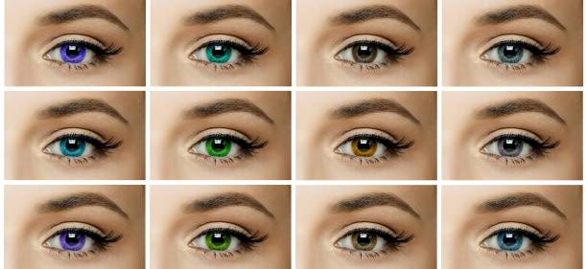
Difference between Editing and Retouching
Retouching: Retouching is the in-depth process of image editing. Here the editor/retoucher has to do a lot of things to get a quality output. For example, teeth whitening, remove unwanted objects or items, remove background, remove undesirable persons, merge two photos, etc. This process is time-consuming and a little bit complex.

Slide 99
Difference between Editing and Retouching
Types of retouching
Retouching is an excellent way to give a professional look in a photo. It makes a photo clean, clear, fresh, and gorgeous. There are different types of retouching services.
High-end retouching:
This type of retouching helps to remove unwanted spots, wrinkles, and any kinds of disturbing things from the face. It gives a better output of a model photo. If you want to use your images on e-commerce sites or billboards, you need to use this service.

Slide 100

Difference between Editing and Retouching

Slide 101
Reference and text books
TEXT BOOKS
Tay Vaughan, “Multimedia making it work”, Tata McGraw-Hill, 2008.
Rajneesh Aggarwal & B. B Tiwari, “Multimedia Systems”, Excel Publication, New Delhi, 2007.
Li & Drew, “Fundamentals of Multimedia”, Pearson Education, 2009.
REFERENCE BOOKS
Parekh Ranjan, “Principles of Multimedia”, Tata McGraw-Hill, 2007
Anirban Mukhopadhyay and Arup Chattopadhyay, “Introduction to Computer Graphics and Multimedia”, Second Edition, Vikas Publishing House.

Slide 102
Any query ??

Slide 103

Thank you

